Slide 1
HANA Studio

Slide 2
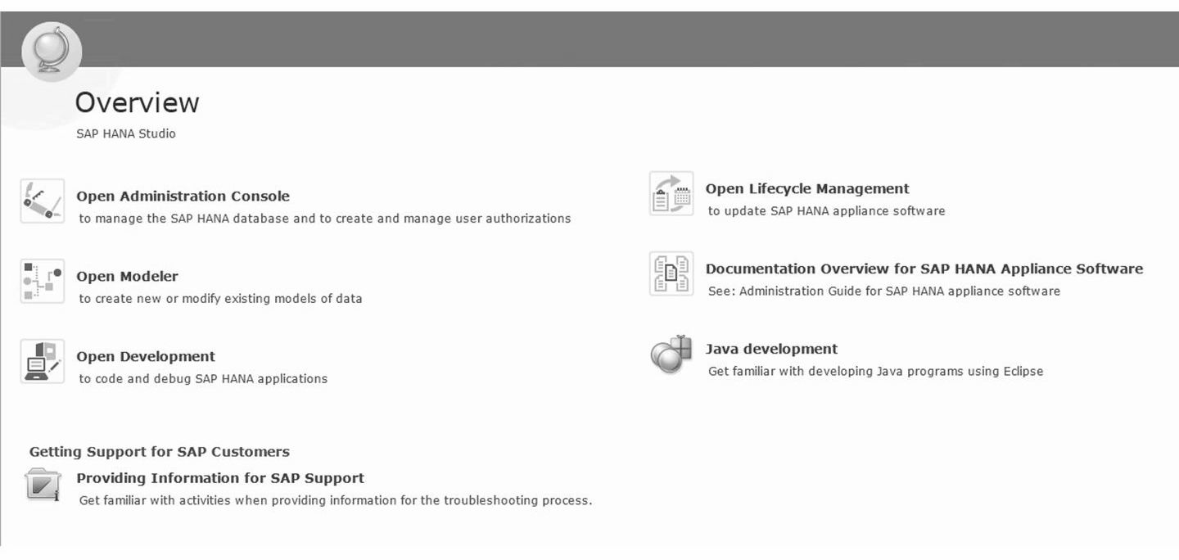
HANA Studio
is a Java based application that runs on the Eclipse platform
delivered in the SAP HANA Appliance
provides an environment for administration, modeling, development and data provisioning
can be installed on a local client PC
Start → Programs → SAP HANA → SAP HANA Studio

Slide 3
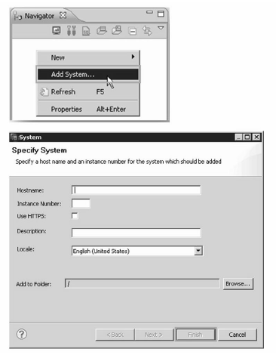
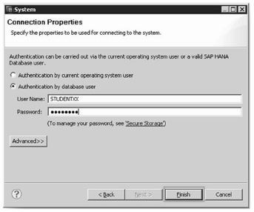
To integrate a SAP HANA system into the studio
- Server where the engine is running and the instance number.
- user/password combination to get a connection to the instance
You can also import (File → import → SAP HANA Studio → Landscape) a system
landscape which has been exported before from another or the same studio.

Slide 4
Perspectives
predefined UI-layouts or views for several application uses
the collection of "screen elements“ or “views”
can be possible to customize the screens and give custom names
Window → Open Perspective → Other
- to view all pre-delivered and saved perspectives

Slide 5
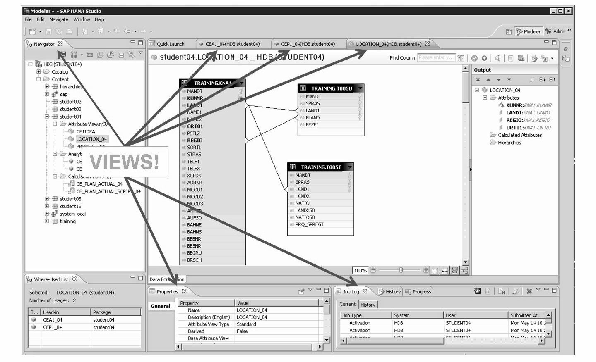
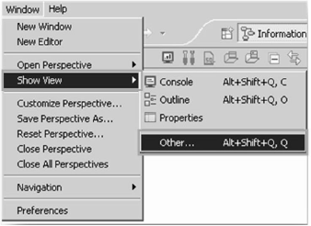
Views
Perspectives are built up based on Views
the basic screen elements
can be moved around via drag & drop
can also be customized

Slide 6
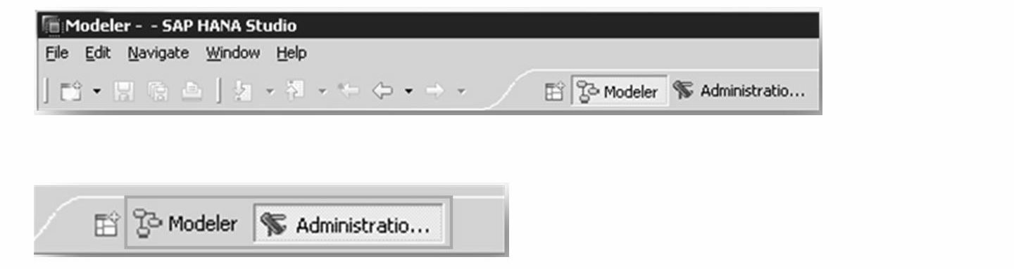
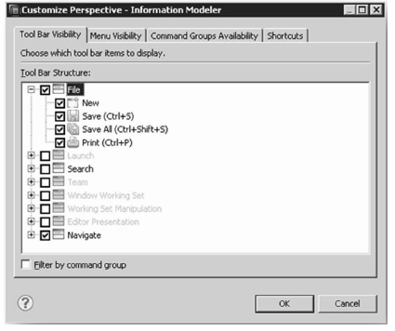
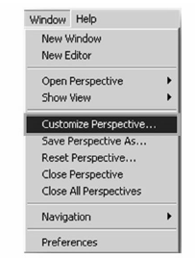
Customization of Perspective

Slide 7
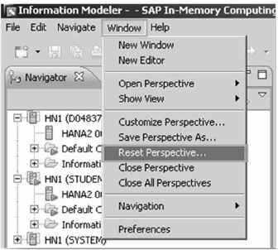
Reset Perspective
Should too much customization have left you lost – there is an easy way to RESET the perspective!

Slide 8
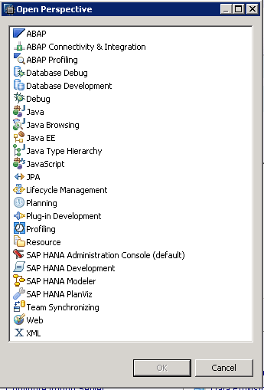
Pre-delivered Perspectives
Administration console - to monitor, configure and diagnose various aspects of SAP HANA server.
Modeler - to create various different types of SAP HANA artifacts such as package, procedure, delivery units etc.
SAP HANA Development - to organize core development artifacts such as repository, projects, development objects etc.
Debug - Developer's efficiency significantly depends upon the debugging tools available. (debugging code)
Lot many other perspectives also available.

Slide 9
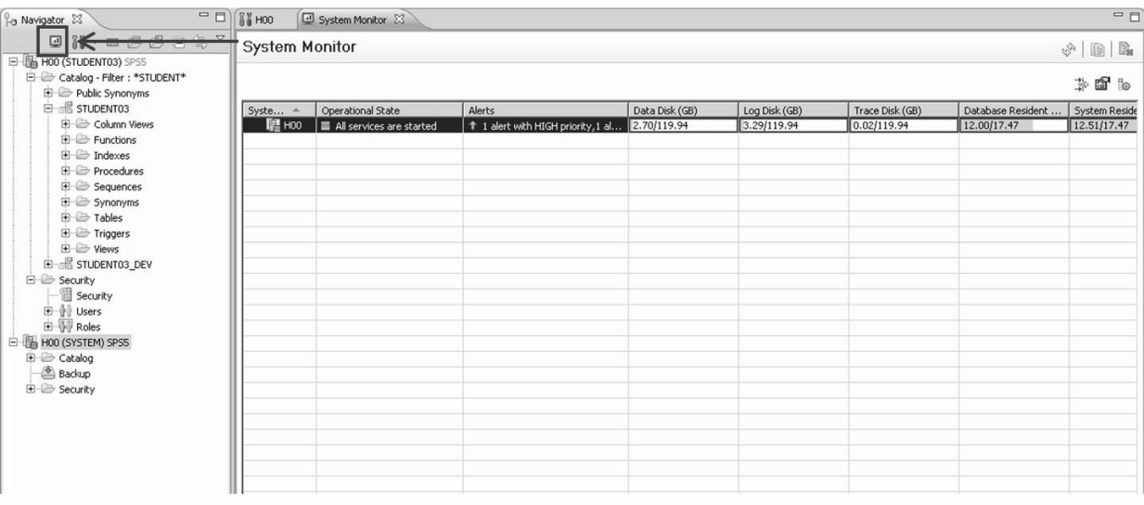
System Monitor
get the most important information about your systems
right click System Monitor view --> Configure Table – to configure which information to be shown
right click System Monitor view --> System Filter - to configure which systems will be shown in system overview

Slide 10
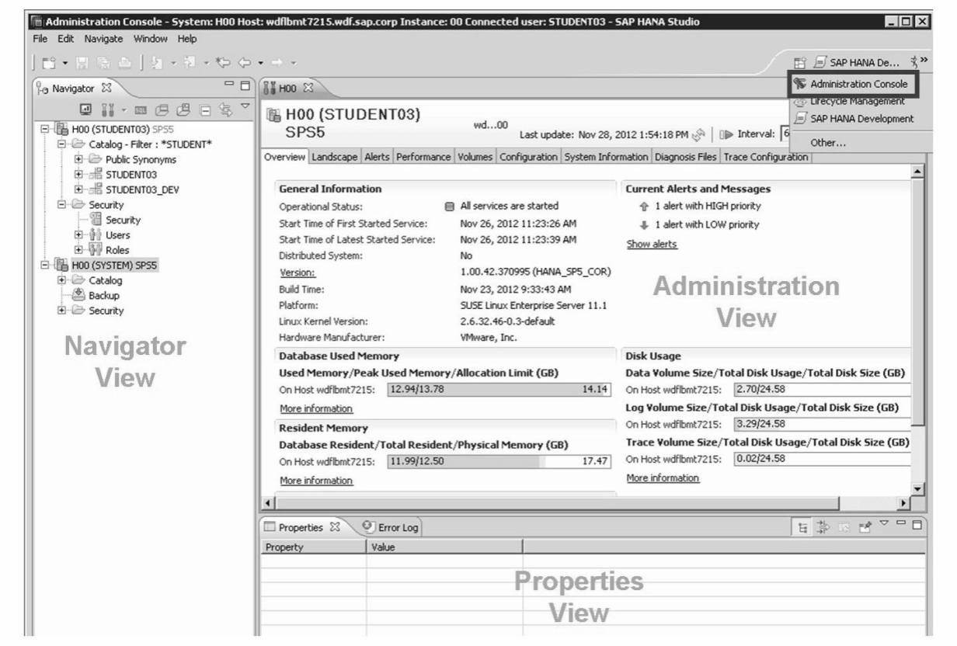
Administration console
Configure the engine instance
Starting and stopping the instance
Backup/recovery of the instance
Monitor the system
Doing the problem analysis

Slide 11
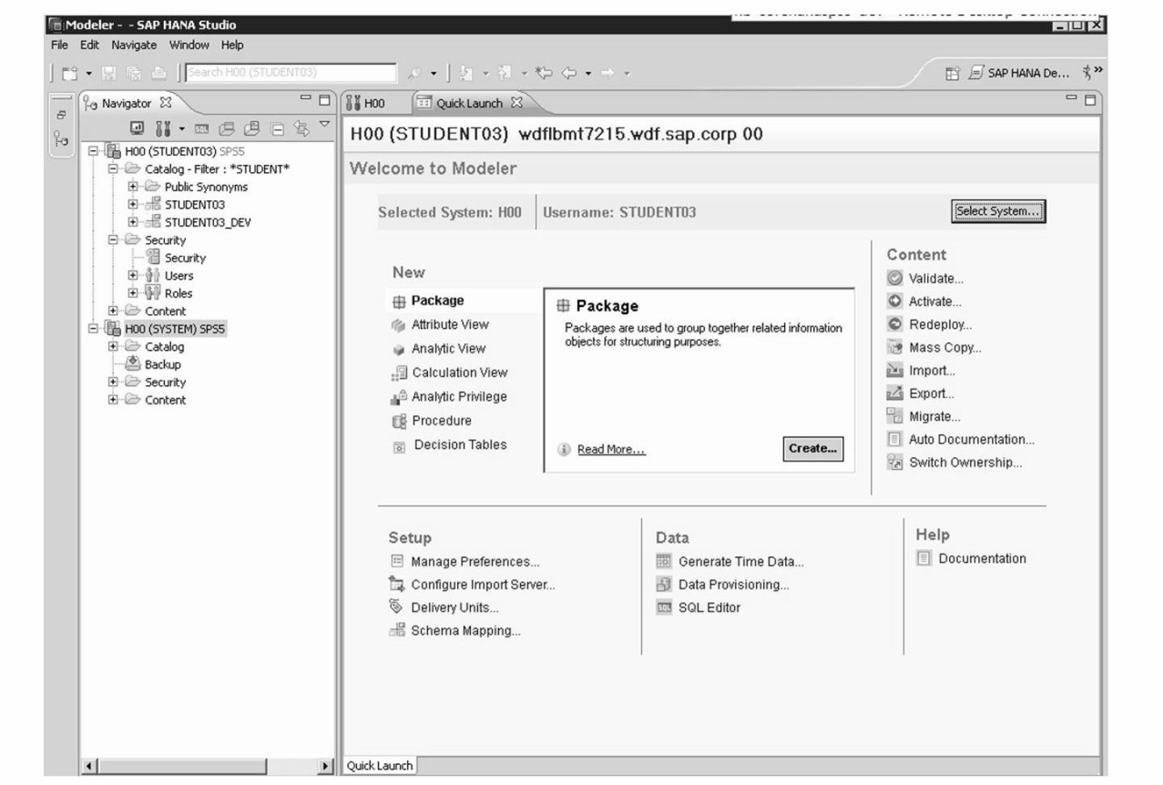
Modeler
Create new Information Models
Import and export source schemas, models and data
Configure the server (Data Provisioning)
Access SAP HANA documentation

Slide 12
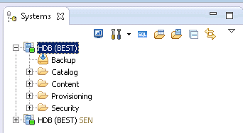
Navigator or Systems View
the central point of Access for SAP HANA Studio
can incorporate several SAP HANA instances directly connected with the appropriate user
three main sections
Catalog node - navigates to the physical tables, views, etc.
Content node - navigates to Attribute Views, Analytic views, Calculation Views, Procedures, Analytical Privileges and Decision Tables.
Security node - navigates to User and Role settings.

Slide 13
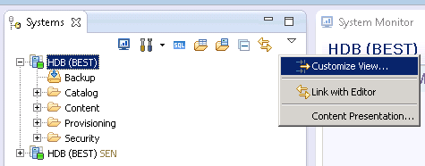
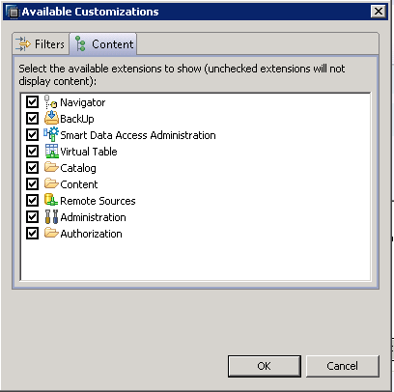
Customize Navigation Tree

Slide 14
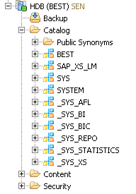
Catalog
contains all Database schemas which will be automatically created when a user is created
each Schema contains a folder for Column Views, Procedures, Tables and Views
Public Synonyms folder contains objects that accessed by all users

Slide 15
Synonyms
a virtual copy of a table and modify access rights for all users to that table
an alternate name for a table, view, procedure or sequence.
To Create Synonym:
CREATE [PUBLIC] SYNONYM <synonym_name> FOR <object_name>
You can use a synonym to re-point functions and stored procedures to differing tables, views or sequences without needing to re-write the function or stored procedure.
Public synonym - can be accessed by any users, but the users that have proper privilege on its base object can access the base object

Slide 16
Schemas
a database folder
during metadata import one defines which schema to hold created tables
different schemas can be useful for grouping tables into categories that have meaning to users
this simplifies the process of identifying which tables to use when defining Information Models
one model can incorporate tables from multiple schemas
do not limit your modeling capabilities
Types of schemas
1. User Defined Schema
2. System Defined Schema
3. SLT Derived Schema

Slide 17
System Defined Schemas
SYS: contains all System Views and System Tables
SYSTEM: contains additional tables and views that display administrative information and to create internal tables and views for system use
_SYS_BI: stores all the metadata of created column Views
_SYS_BIC: run time object (column view) of all the activated HANA Models
_SYS_REPO: Whatever the objects are there in the system is available in repository
_SYS_STATISTICS: All the system configurations and parameters
_SYS_XS: XS stands for XML Server engine where all the 3rd party Web Services can connect & communicate
_SYS_AFL: for Application function library (BFL & PAL)

Slide 18
Creating new schema
CREATE SCHEMA <schema_name> [OWNED BY <user_name>]
Example
CREATE SCHEMA my_schema OWNED BY system;
To grant Access:
GRANT SELECT ON SCHEMA my_schema TO _SYS_REPO WITH GRANT OPTION

Slide 19
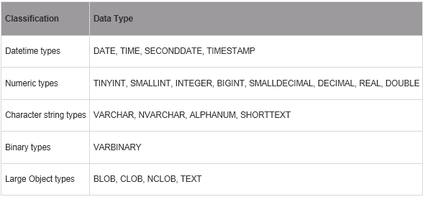
Classification of data types

Slide 20
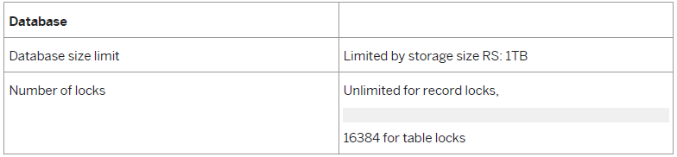
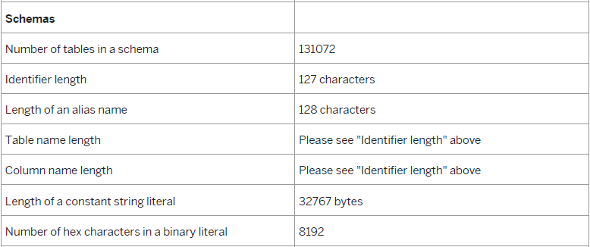
Limitations of HANA database

Slide 21
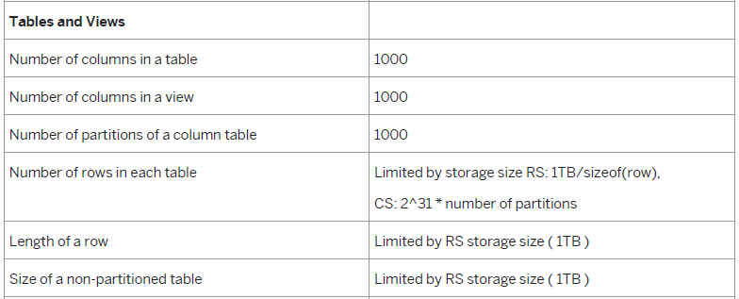
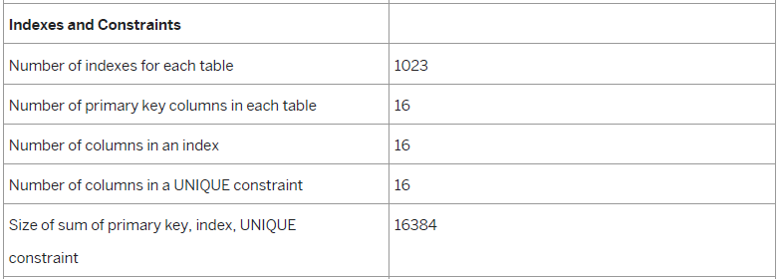

Slide 22

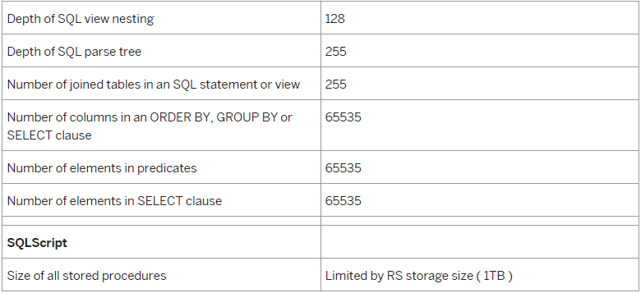


Slide 23
THANK YOU

